Slide 1



Unlocking Finance for a Resilient WEFE (Water-Energy-Food-Ecosystems) Nexus in Egypt
Dr. Hassan Tolba Aboelnga

Slide 2
WEFE Nexus Professional Series: Driving Finance and Resilience for Egypt’s Future”
Lecture | Title | Objective
1 | WEFE Nexus Project Identification and Classification – Financing Perspective | Identify WEFE projects, classify for financiers, understand bankability and risk.
2 | Integrating WEFE Nexus into Existing Projects to Enhance Economic Value | Apply integration to reduce costs, improve revenues, increase financing attractiveness.
3 | Financing Instruments & Capital Stack in WEFE Nexus Projects | Understand instruments, capital stack, blended finance, and matching to project stages.
4 | Financing Risks During Operations & How to Manage Them | Identify operational risks, manage cashflow stress, apply mitigation tools.
5 | Navigating WEFE Nexus Funding Calls — Where to Find Them & How to Understand Them | Recognize funding sources, decode calls, apply fit-scoring, organize response workflows.

Slide 3
Integrating WEFE Nexus into Existing Projects to Enhance Economic Value
Training professionals to design bankable, resilient, and integrated WEFE projects

Slide 4
Integrating WEFE Nexus into Existing Infrastructure
From Cost Centers to Bankable, Climate-Resilient Assets
Focus: Retrofitting existing infrastructure
Case: Agricultural Drainage Desalination (Egypt)
Approach: Technical + Financial + Governance

Slide 5
Strategic Framing
Shift from silo-based planning to system efficiency
Drivers: climate change, water scarcity, energy volatility
Transition from CAPEX focus to lifecycle value
Investors demand ESG-compliant resilient assets

Slide 6
Lecture Objectives
Identify cross-sector inefficiencies
Quantify economic and financial co-benefits
Transform projects into bankable investments
Enable access to climate and blended finance

Slide 7
Core Problem: Sectoral Inefficiency
Water ignores energy cost
Energy ignores water demand
Agriculture ignores sustainability
Result: system-wide inefficiency and high OPEX

Slide 8
WEFE Nexus Model
Integrates water-energy-food-ecosystems
Captures interdependencies and trade-offs
Optimizes system performance
Reduces risks across sectors

Slide 9
Economic Logic of WEFE
Cost reduction (energy, losses)
Revenue generation (water, agriculture)
Risk mitigation (climate, price shocks)
Asset revaluation into investment-grade

Slide 10
Egypt Context
Water scarcity <600 m3/capita/year
Drainage reuse ~20 BCM/year
Mega projects: Bahr El-Baqar, Al Mahsama
Challenges: salinity and energy cost

Slide 11
System Complexity
Water: treatment and reuse
Energy: pumping and desalination
Food: irrigation and yield
Ecosystem: environmental impacts

Slide 12
Water Inefficiencies
Losses 25–40%
High salinity increases treatment cost
Inefficient reuse systems
Direct economic losses

Slide 13
Energy Inefficiencies
RO: 3–5 kWh/m3
Pumping significant share of cost
Energy = 40–60% OPEX
High exposure to price volatility

Slide 14
Food Inefficiencies
Yield loss 10–30%
Over-irrigation practices
Soil salinity impacts productivity
Reduced farmer income

Slide 15
Ecosystem Externalities
Pollution and eutrophication
Biodiversity loss
Impact on fisheries
Hidden economic costs

Slide 16
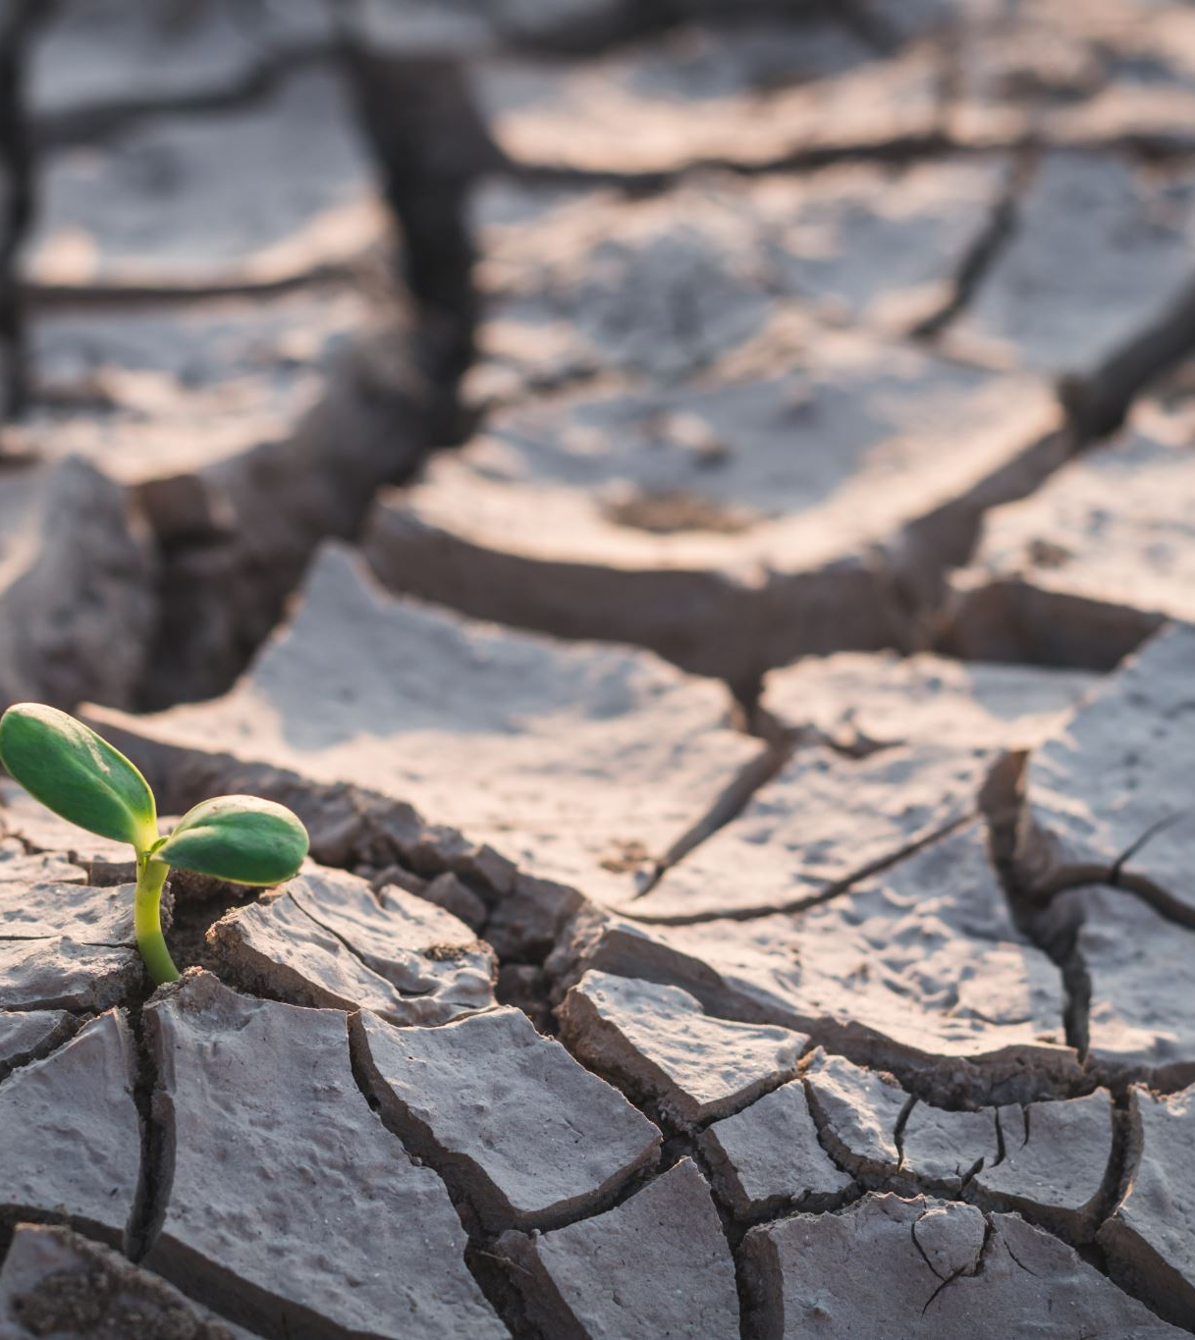
Hidden Costs
Environmental degradation
Energy price risks
Water scarcity risks
Soil productivity decline

Slide 17
WEFE Entry Points
Efficiency: low cost, fast impact
Integration: medium cost, high impact
Infrastructure: high cost, transformational

Slide 18
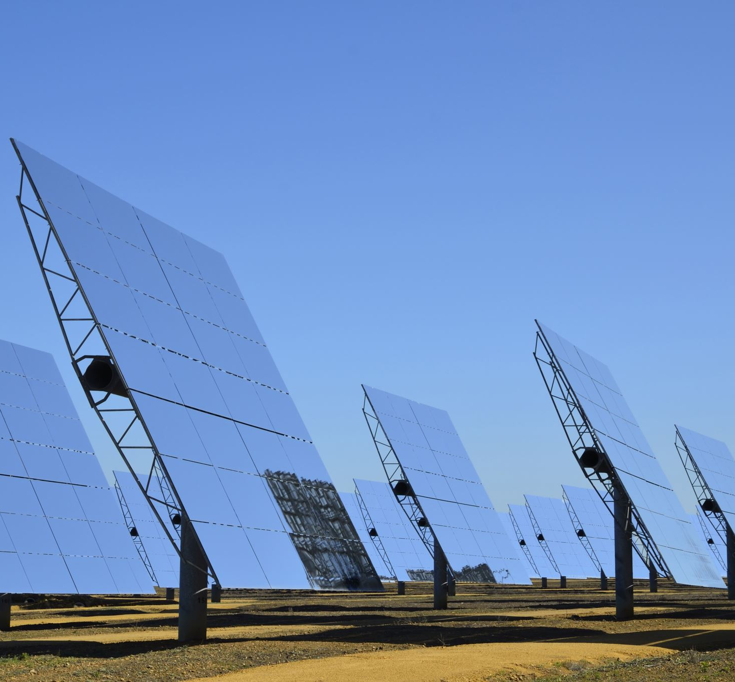
Renewable Energy Integration
Solar PV for desalination
Hybrid grid systems
Energy storage integration
Reduce OPEX 20–50%

Slide 19
Water Optimization
Smart irrigation systems
AI-based allocation
Water blending strategies
Water savings 20–30%

Slide 20
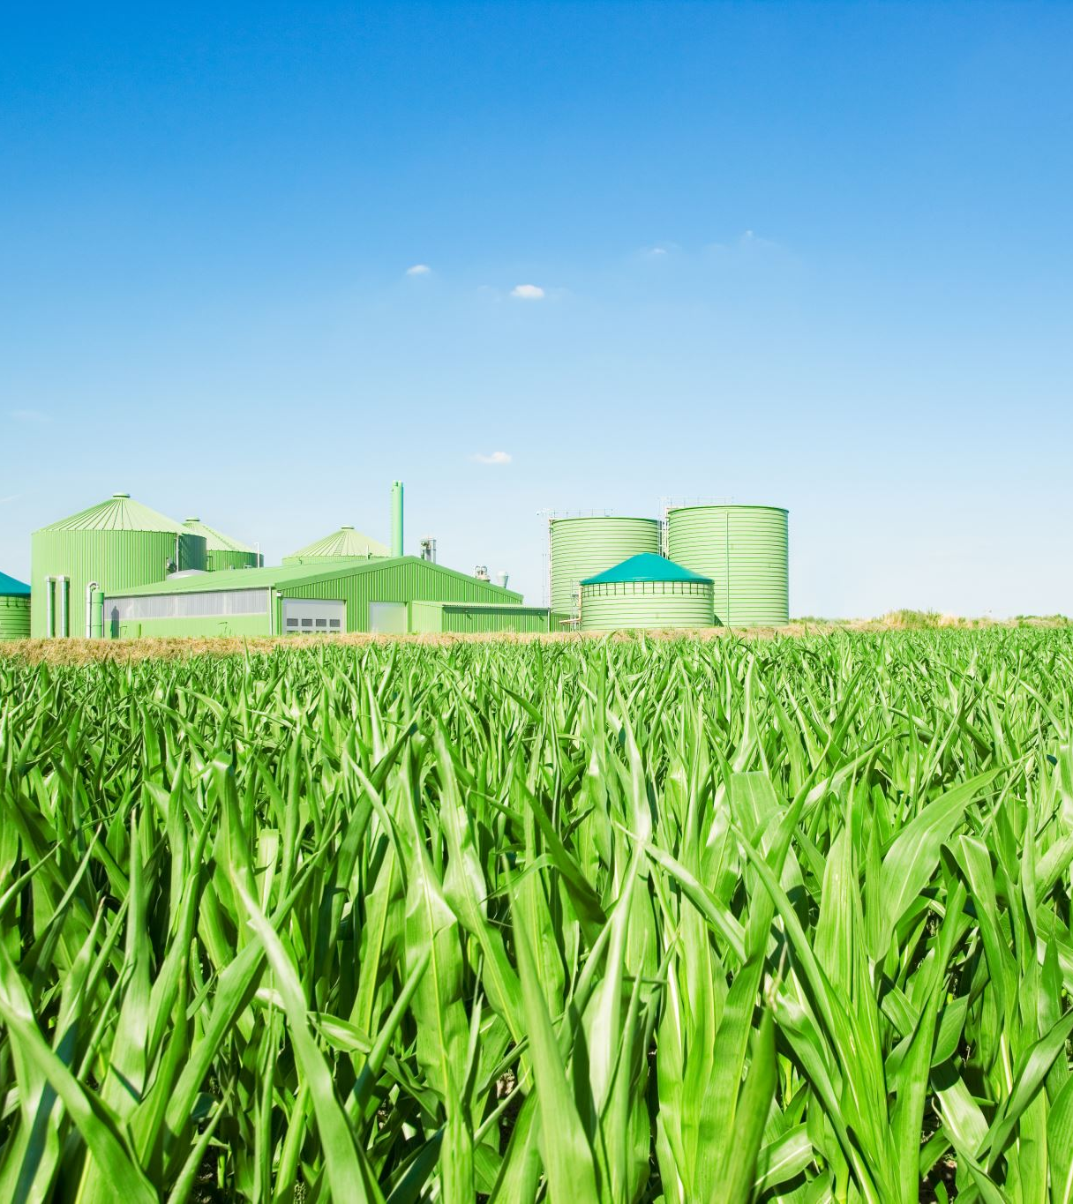
Circular Economy
Sludge to biogas
Nutrient recovery
Reduced waste costs
New revenue streams

Slide 21
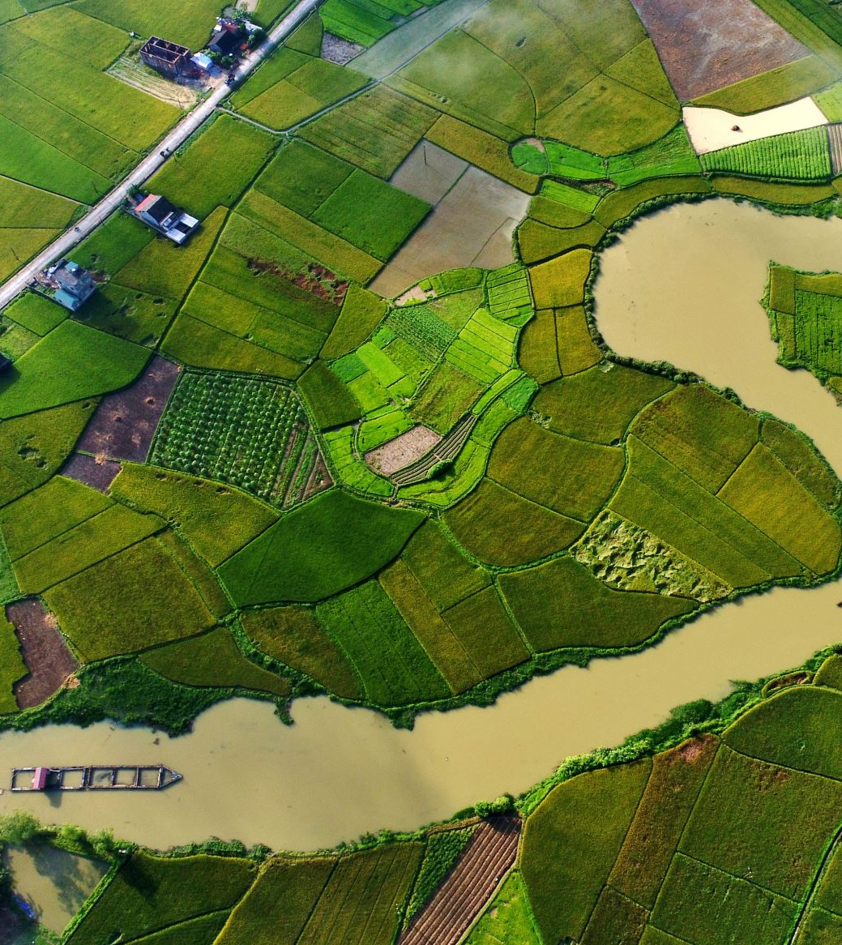
Nature-Based Solutions
Constructed wetlands
Biofiltration systems
Lower treatment costs
Improved ecosystem services

Slide 22
OPEX Reduction
Energy savings
Reduced losses
Lower chemical use
Total reduction 20–40%

Slide 23
Efficiency Gains
Water productivity increase
Energy intensity decrease
Land productivity improvement
Higher economic output

Slide 24
Revenue Streams
Water tariffs
Agricultural output
Carbon credits
Resource recovery

Slide 25
Risk Reduction
Reduced climate risks
Lower energy price exposure
Improved resilience
Lower cost of capital

Slide 26
Asset Repositioning
From cost-heavy infrastructure
To revenue-generating asset
Improved investment profile
Enhanced sustainability

Slide 27

Climate Finance
Green bonds
GCF and GEF
Blended finance instruments
ESG alignment

Slide 28

Blended Finance
Public capital reduces risk
Private capital scales investment
Leverage ratios up to 1:7
Improved project viability

Slide 29

Risk Instruments
Guarantees
Insurance mechanisms
Catastrophe bonds
Improved investor confidence

Slide 30

Bankability
Higher IRR
Stable cash flows
Improved creditworthiness
Attract private investors

Slide 31

Case Diagnosis
Energy-intensive system
Water losses present
Limited integration
Environmental impacts

Slide 32
Quick Wins
Energy audits
Leak reduction
Operational improvements
Payback <2 years

Slide 33
Medium-Term Actions
Solar integration
Advanced membranes
System integration
Digital monitoring

Slide 34
Financial Impact
OPEX reduction 20–40%
Yield increase 10–30%
Revenue diversification
Improved profitability

Slide 35
Bankability Impact
Lower perceived risk
Reduced cost of capital
Higher returns
Stronger investment case

Slide 36
Strategic Insight
WEFE is not only technical
It is financial structuring tool
Aligns engineering with finance
Enables scalable investments

Slide 37
Key Takeaways
Integration creates value
Efficiency drives profitability
Finance follows risk reduction
Systems thinking is essential

Slide 38
Closing Insight
Future infrastructure is integrated
Climate resilience is mandatory
WEFE enables sustainable growth
Investment flows follow integration

Slide 39
Thank you

